Slide 1

Unemployment Insurance
Benefits Data Validation (DV)
Knowledge Management System (KMS)
Rachel Beistel
India Oliver
US Department of Labor
Notes:
We’re very excited to present to you a new data validation tool, the Benefits Data Validation Knowledge Management System also referred to as KMS. This tool was developed in collaboration with Mathematica Policy Research.
This PowerPoint includes screen shots on how to access, navigate and utilize the Data Validation Knowledge Management System for the sixteen benefit populations as well as a few key topic areas.

Slide 2
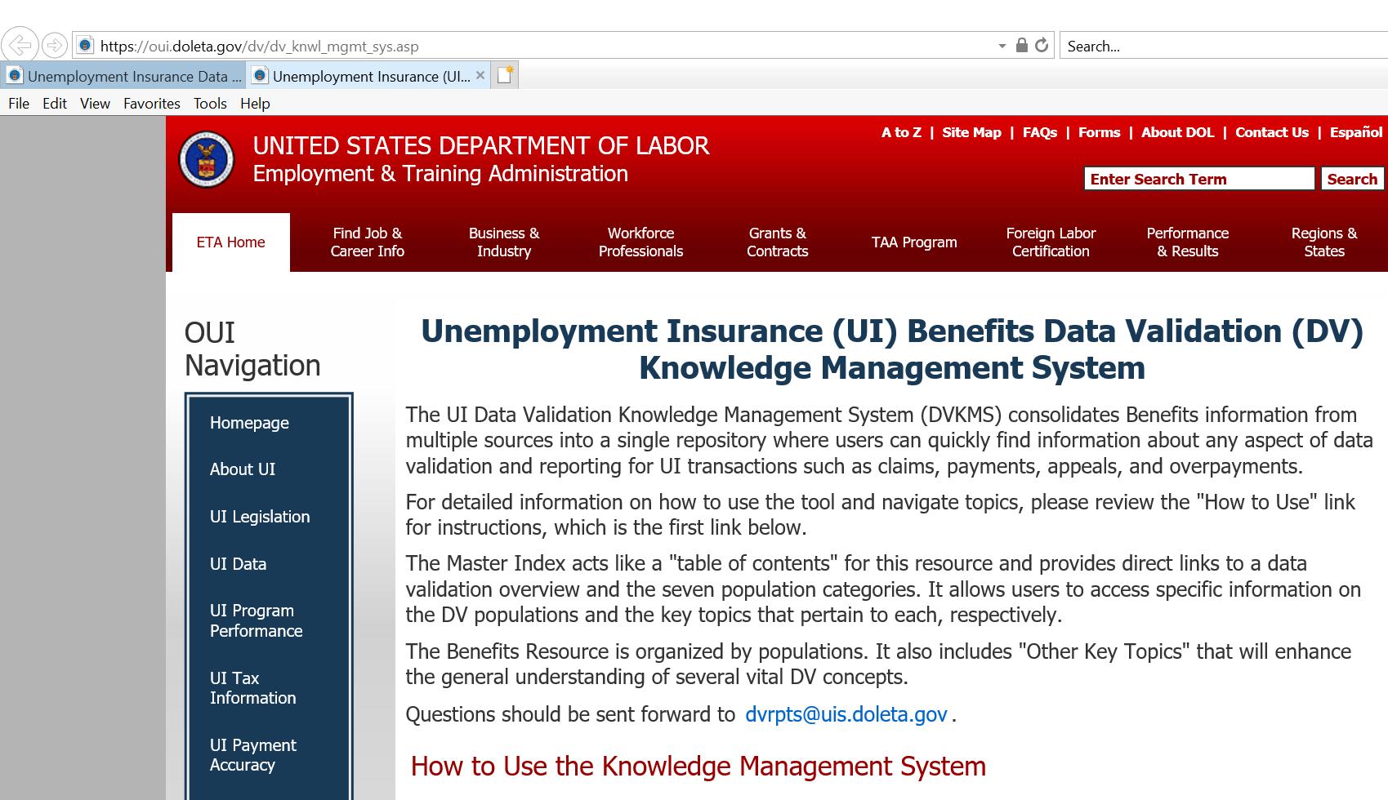
What is the KMS?
Notes:
You will access the Knowledge Management System on the DOL Data Validation webpage under “What’s New.” After clicking the link, you will be redirected to the KMS webpage.
The knowledge management system consolidates information from UI and data validation resources into a single repository allowing users to quickly find information for data validation and reporting for UI transactions.
On this page, there are three main sections: How to Use the Knowledge Management System (Instructions document), Master Index and Benefit Resources. Each section will populate in a separate window to view.

Slide 3
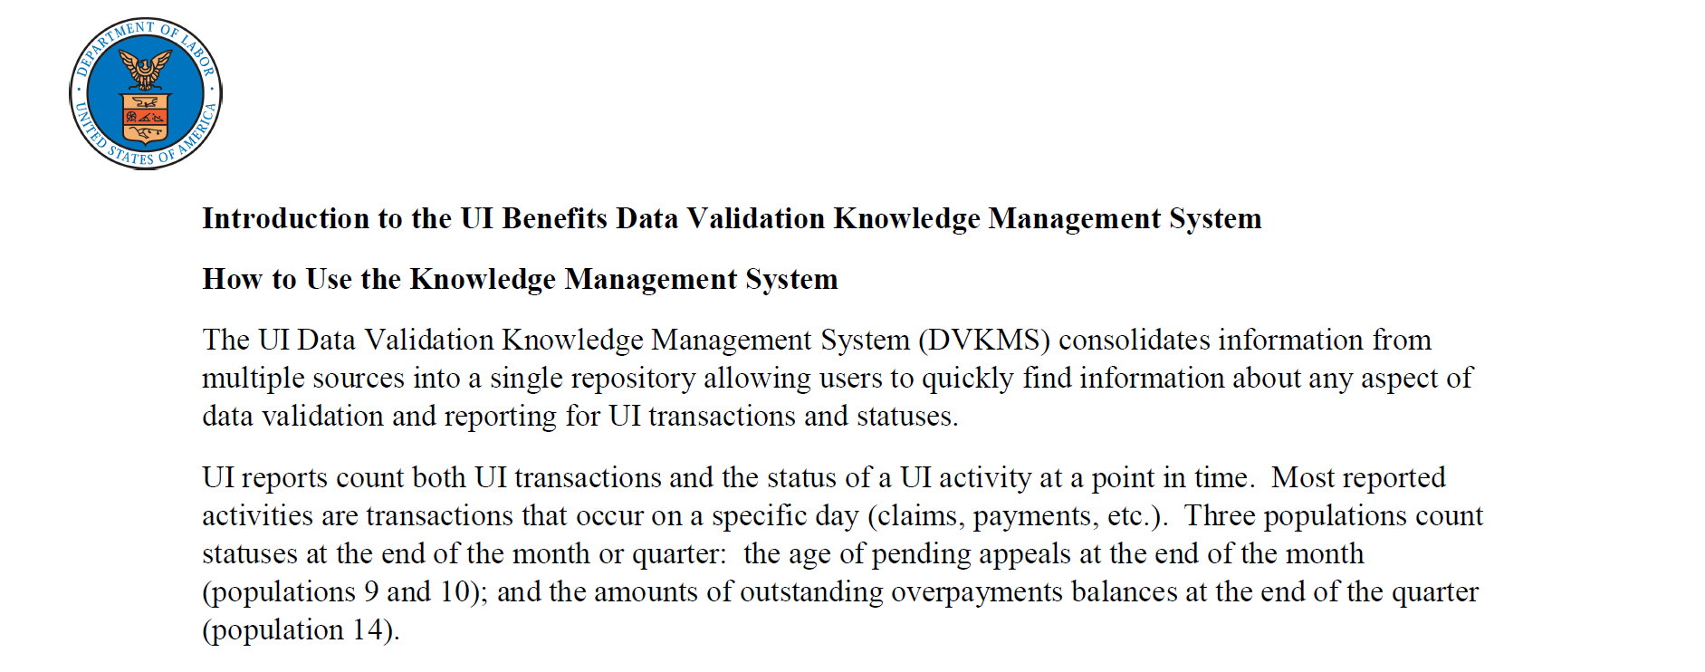
Instructions
Notes:
The First Red link on the KMS landing page is : How to use the Knowledge Management System – this page provides a brief explanation of the purpose of the management system, transactions and statuses and highlight the difference in reporting time periods.
Some populations count transactions and statuses at the end of the month, while others count at the end of the quarter. For example, the status for age of pending appeals is counted at the end of the month while age of overpayments is counted at the end of the quarter.

Slide 4
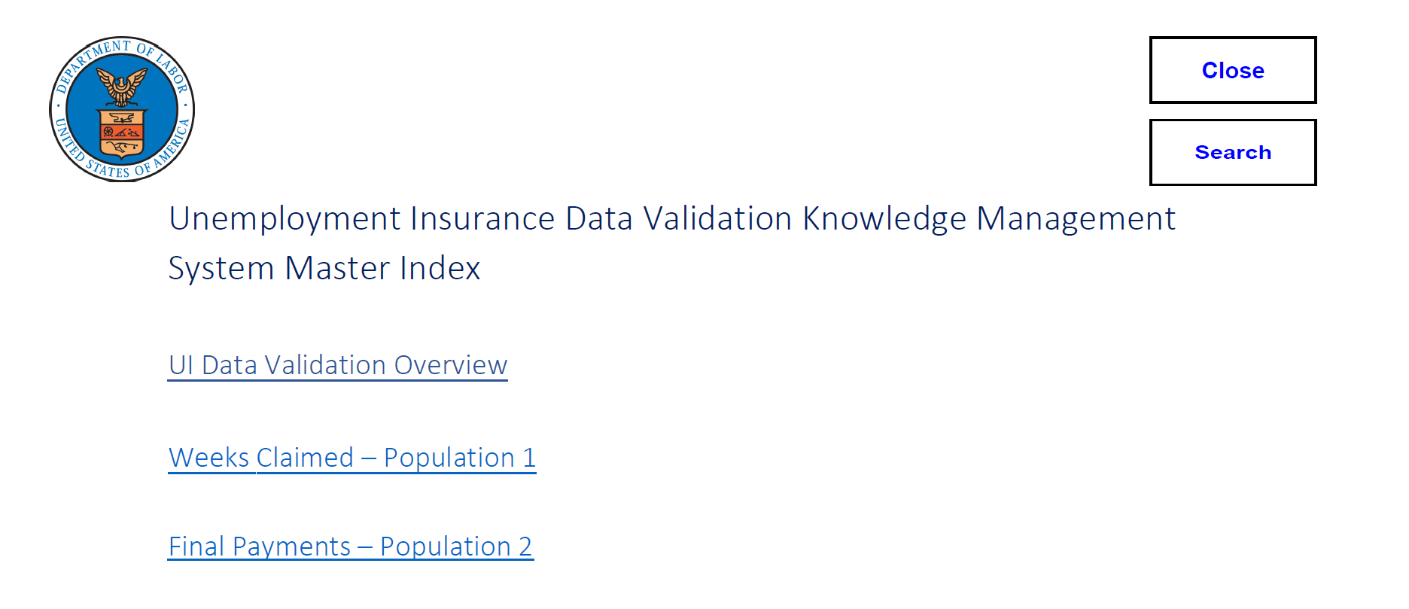
Master Index
Notes:
2nd red link on the KMS landing page is the Master Index . On this page you will notice a search function.
By clicking on the search function the user will also see icons for page thumbnails, add attachments, view layers and search the document by word or phrase. For example, if you select Overpayments (OP) and then search “Penalty” or Accumulated Federal Amount”, the search feature will examine all the OP populations for the requested word or phrase.

Slide 5
KMS Combines DV Information into One Searchable Resource
Each Population includes information from UI Reporting and DV Handbooks:
UI DV Benefits Handbook (ETA 361)
Benefits Module 3 Data Element Validation Instructions
UI Reporting Handbook (ETA 401, 5th Edition)
UI DV Operations Guide (ETA 411)
The Master Index Includes links to the following:
  UI DV Overview (KMS Instructions)
  Seven Population Categories
  Within these populations, there are links to “Other Key Topics” that will help enhance understanding of vital DV concepts
Notes:
The Master Index consist of links to the following:
KMS Instructions
The 16 benefit populations that are listed in 7 categories
And Other Key Topics that will help enhance understanding of vital DV concepts.
Each population category includes information from UI Reporting and DV Handbooks:
UI DV Benefits Handbook (ETA 361); Subpopulation specifications
Federal Benefits Module 3, Data Element Validation Instructions/Rules
UI Reporting Handbook (Handbook - 401, 5th Edition)
And the UI DV Operations Guide - (Handbook 411); Record Layouts

Slide 6
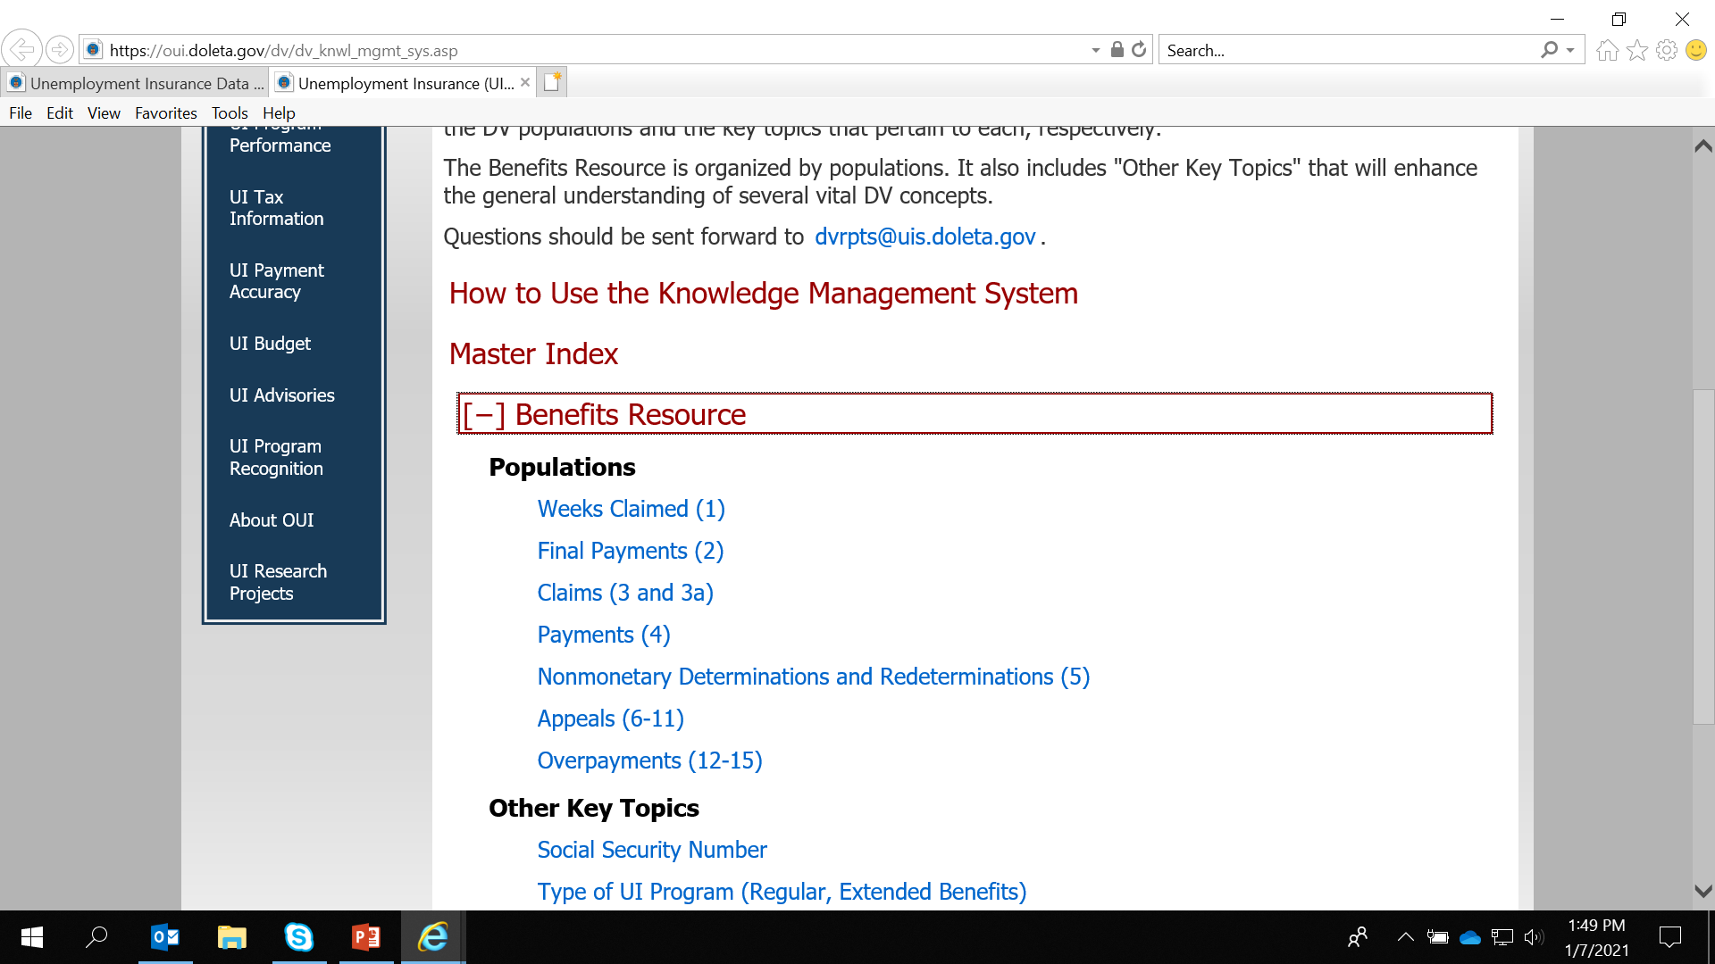
Resource Options
Notes:
The third section on the KMS webpage is the Benefit Resources. Clicking on the plus sign (or expansion symbol) will reveal the benefit populations below and the other key topics section.
You can directly access information to a particular population by clicking on the population link.

Slide 7
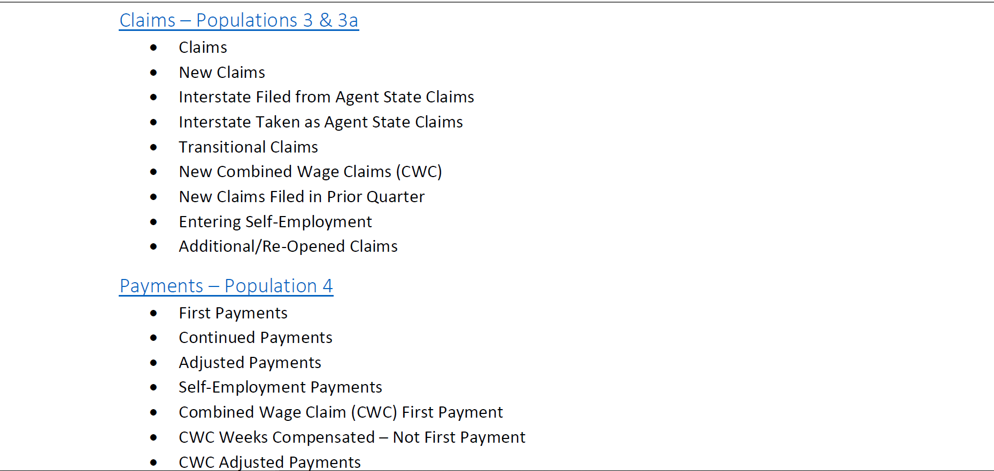
Topics Included in Population Information as Part of Master Index
Notes:
The associated report elements are listed below the transaction type/status for each population.

Slide 8
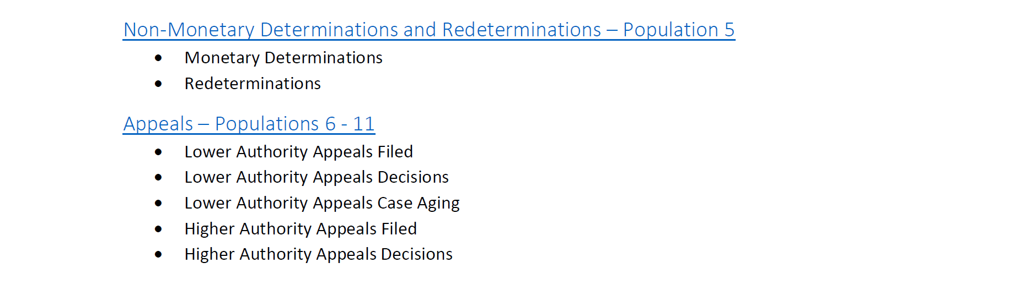
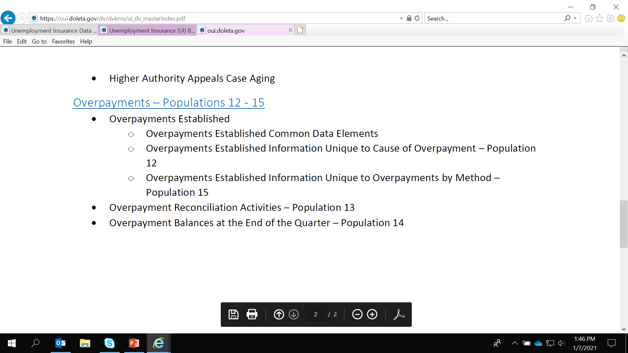
Continued Benefits Populations and Topics
Notes:
Many of the populations are listed under the overall category for Appeals and Overpayments, including different statuses and transaction types for Appeals (6 pops) and Overpayments (4 pops).
Population 6 – Lower Authority Appeals Filed
Population 7 – Higher Authority Appeals Filed
Population 8 – Lower Authority Appeals Decided
Population 9 – Higher Authority Appeals Decided
Population 10 – Lower Authority Appeals Case Aging
Population 11 – Higher Authority Appeals Case Aging
Overpayment populations:
Population 12 – Overpayments Established by Cause
Population 13 – Overpayments Reconciliation
Population 14 – Age of Overpayments
Population 15 – Overpayments Established by Detection Method

Slide 9
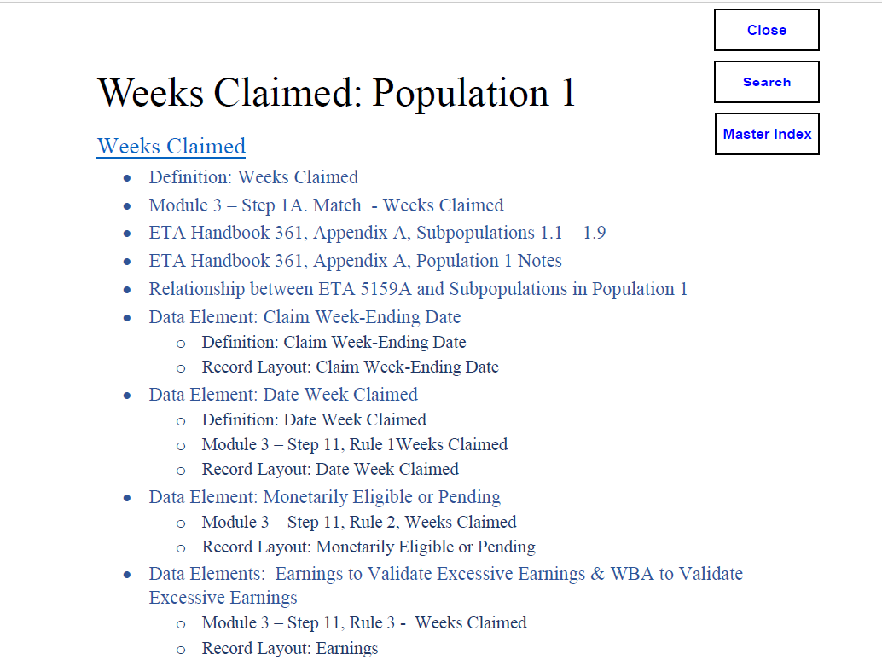
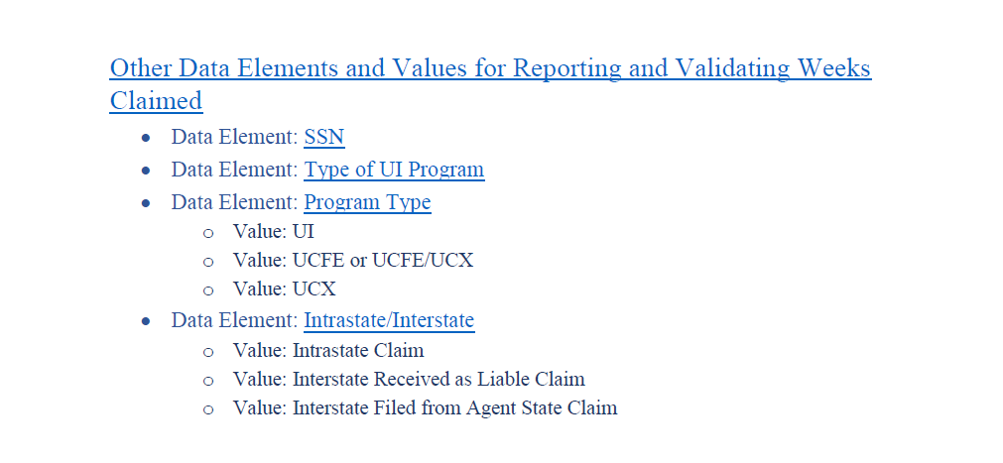
Example: Population 1 and Table of Contents
Notes:
We’ll use Population 1 – Weeks Claimed as an example.
This first page of the Pop 1 chapter lists all the information included and acts as a TOC
For each main data element that make up a population – any pertinent definition, Module 3, and record layout information will also be provided.
For Pop 1 this includes Date Week Claimed, Monetarily Eligible, and Earnings
In PowerPoint presentation, this TOC will be included on the slides in the right hand side with red arrows to help understand navigation of resource tool

Slide 10
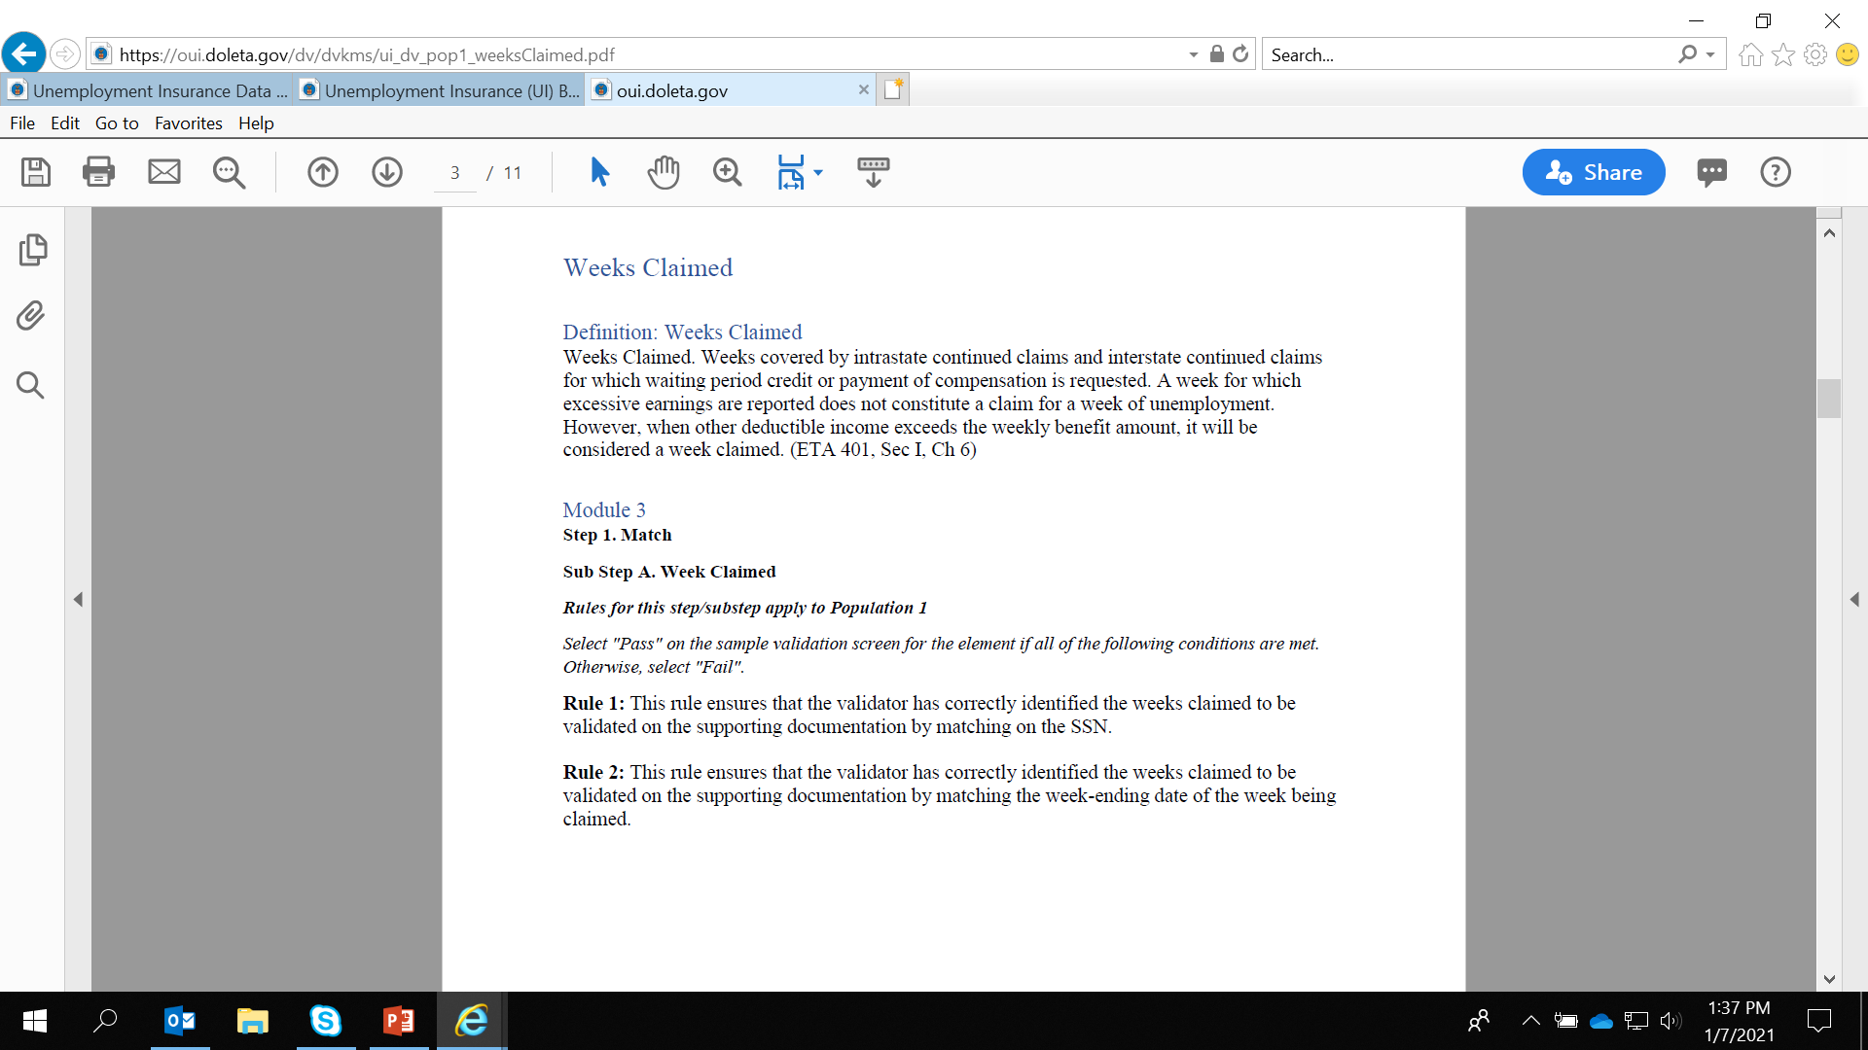
Definition and Associated Module 3 Steps
Notes:
First, for Weeks Claimed, you will find the definition from the 401 Reports HB and Module 3 Step with the Rules

Slide 11
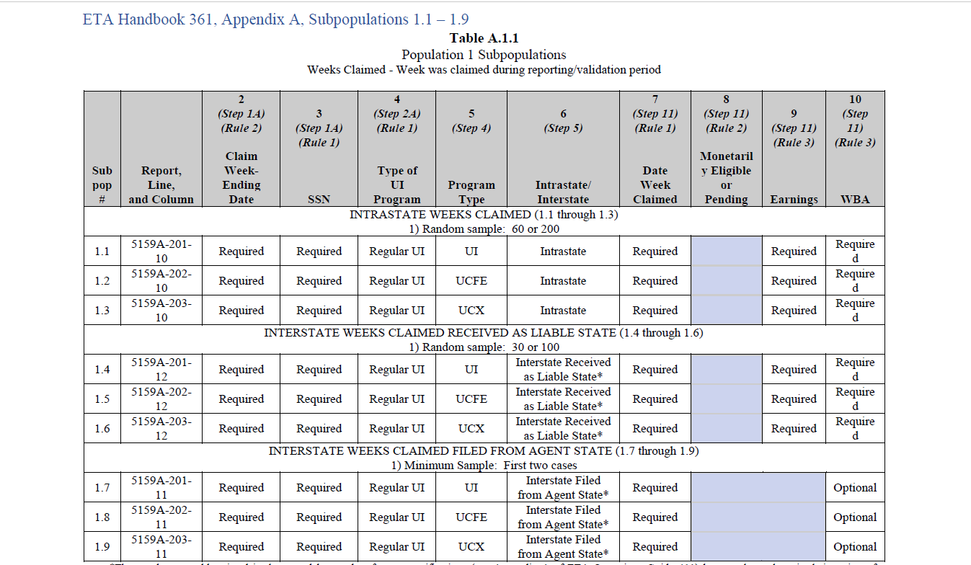
Subpopulation Specifications (ETA 361)
Notes:
Then, as noted in the Population TOC – Appendix A of the 361 Subpopulation Specifications
There are 9 subpopulations for Pop 1: As you can see fields 3, 4, 5, and 6 are data elements that are included in the KMS “Other Key Topics”
Fields 7, 8, 9, and 10 are the other main data elements of the population and specific details on these elements are included in this Pop 1 chapter of the KMS that we previously mentioned.
In any subpopulation specification tables, blue or grey boxes indicate an optional field

Slide 12
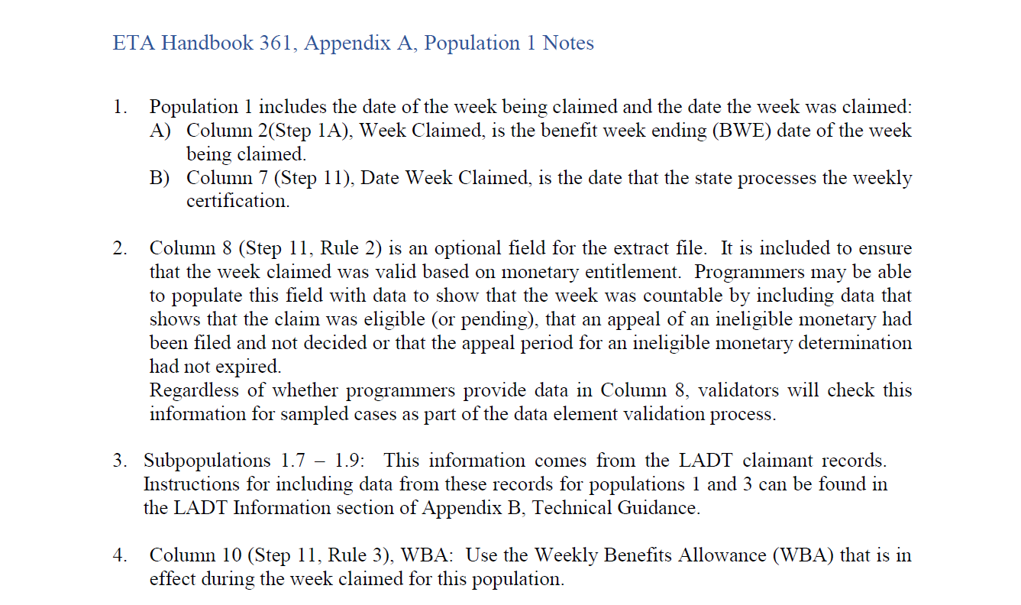
Population Notes
Notes:
At the end of each population in the 361 HB, there is a Notes section – these have been incorporated into the KMS

Slide 13
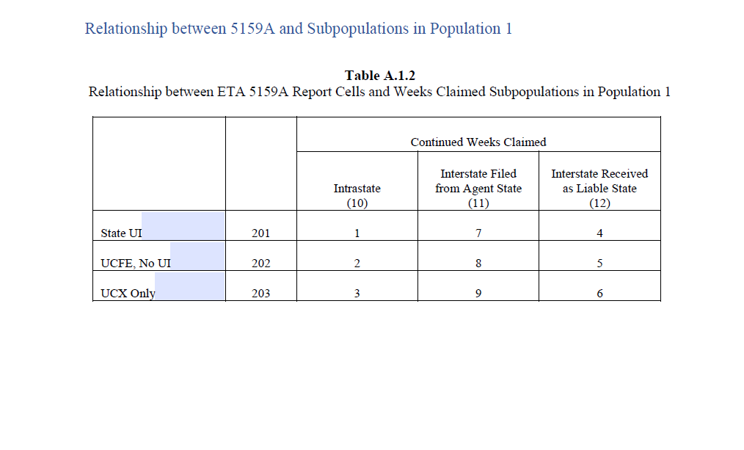
Report Cells Validated by Population
Notes:
Lastly, included are the charts that show what report cell is validated by the corresponding subpopulation (Line 210, Column 10)
In this example, one subpopulation validates one report cell; this may not always be the case as more than one subpopulation can validate a report cell.

Slide 14
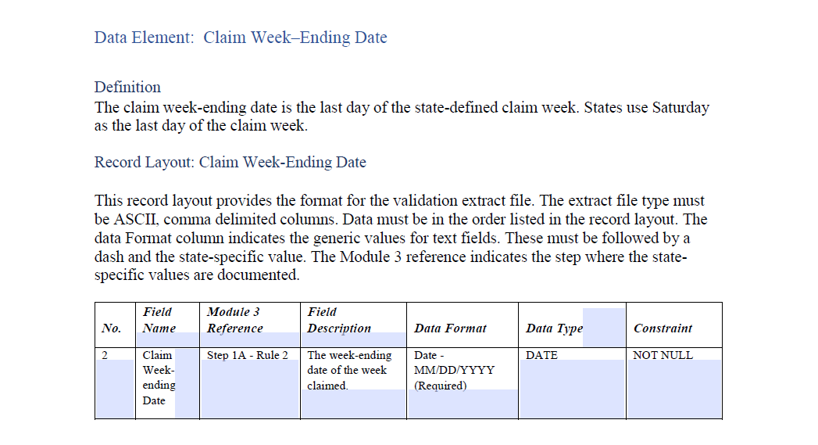
Data Elements and Record Layout (ETA 411)
Notes:
For other key data elements that make up the subpopulation, also included is the definition/record layout information. The record layout is part of HB 411 - the DV Operations Guide.
The No. field is just a sequential indicator. The record layout lists the reference to particular step/rule in Module 3, a description of the data element, the format and type (in this case an 8 digit date) and any constraint (not null= required)

Slide 15
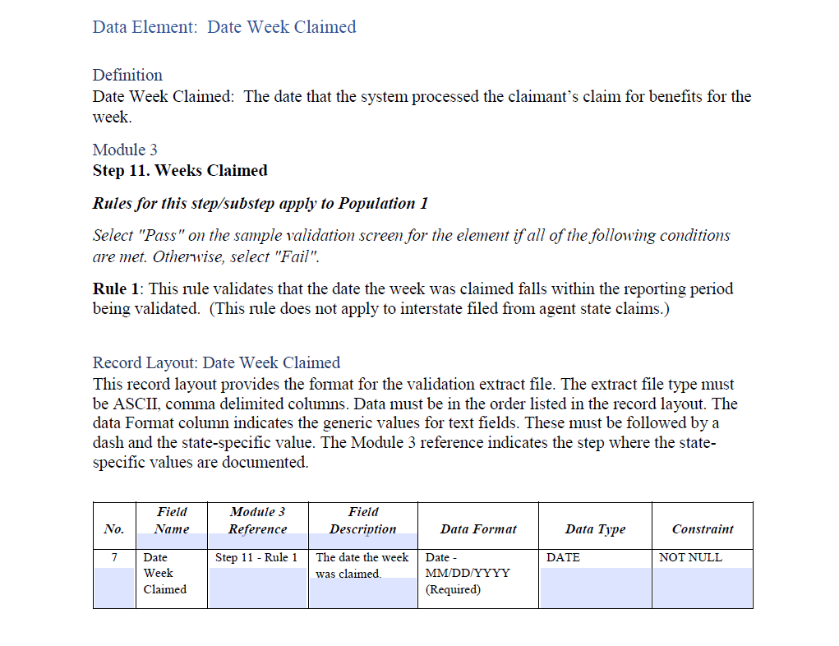
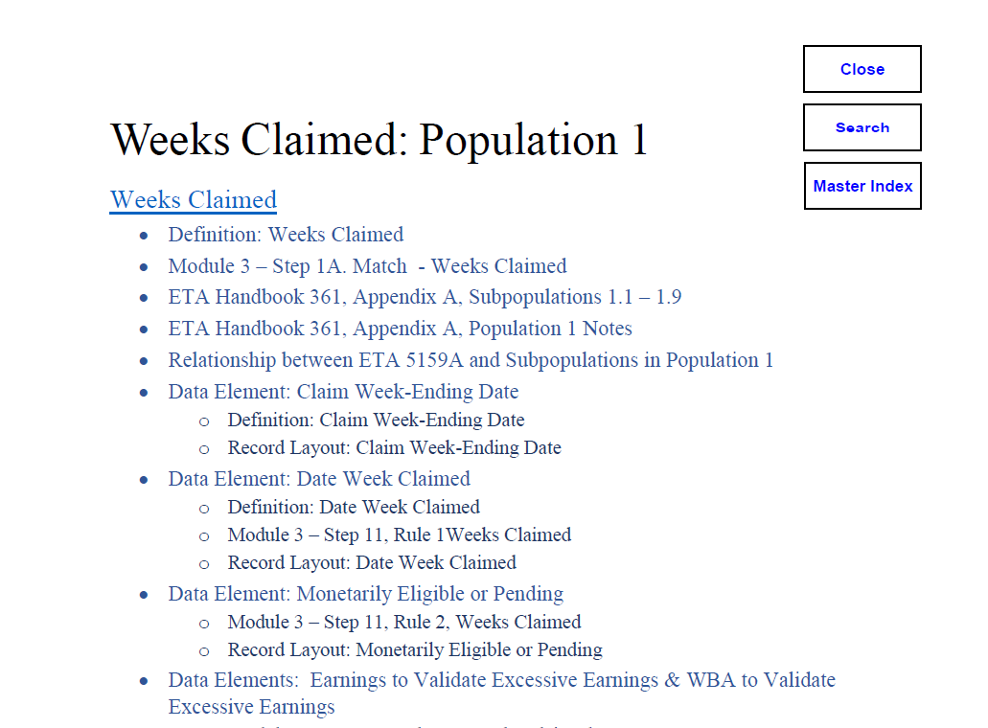
Next in Table of Contents for Population:
Date Week Claimed
Notes:
For other key data elements that make up the subpopulation, also included the definition/record layout information. The record layout is part of the 411 DV Operations HB
The No. field is just a sequential indicator. The record layout lists the reference to particular step/rule in Module 3, a description of the data element, the format and type (in this case an 8 digit date) and any constraint (not null= required)

Slide 16
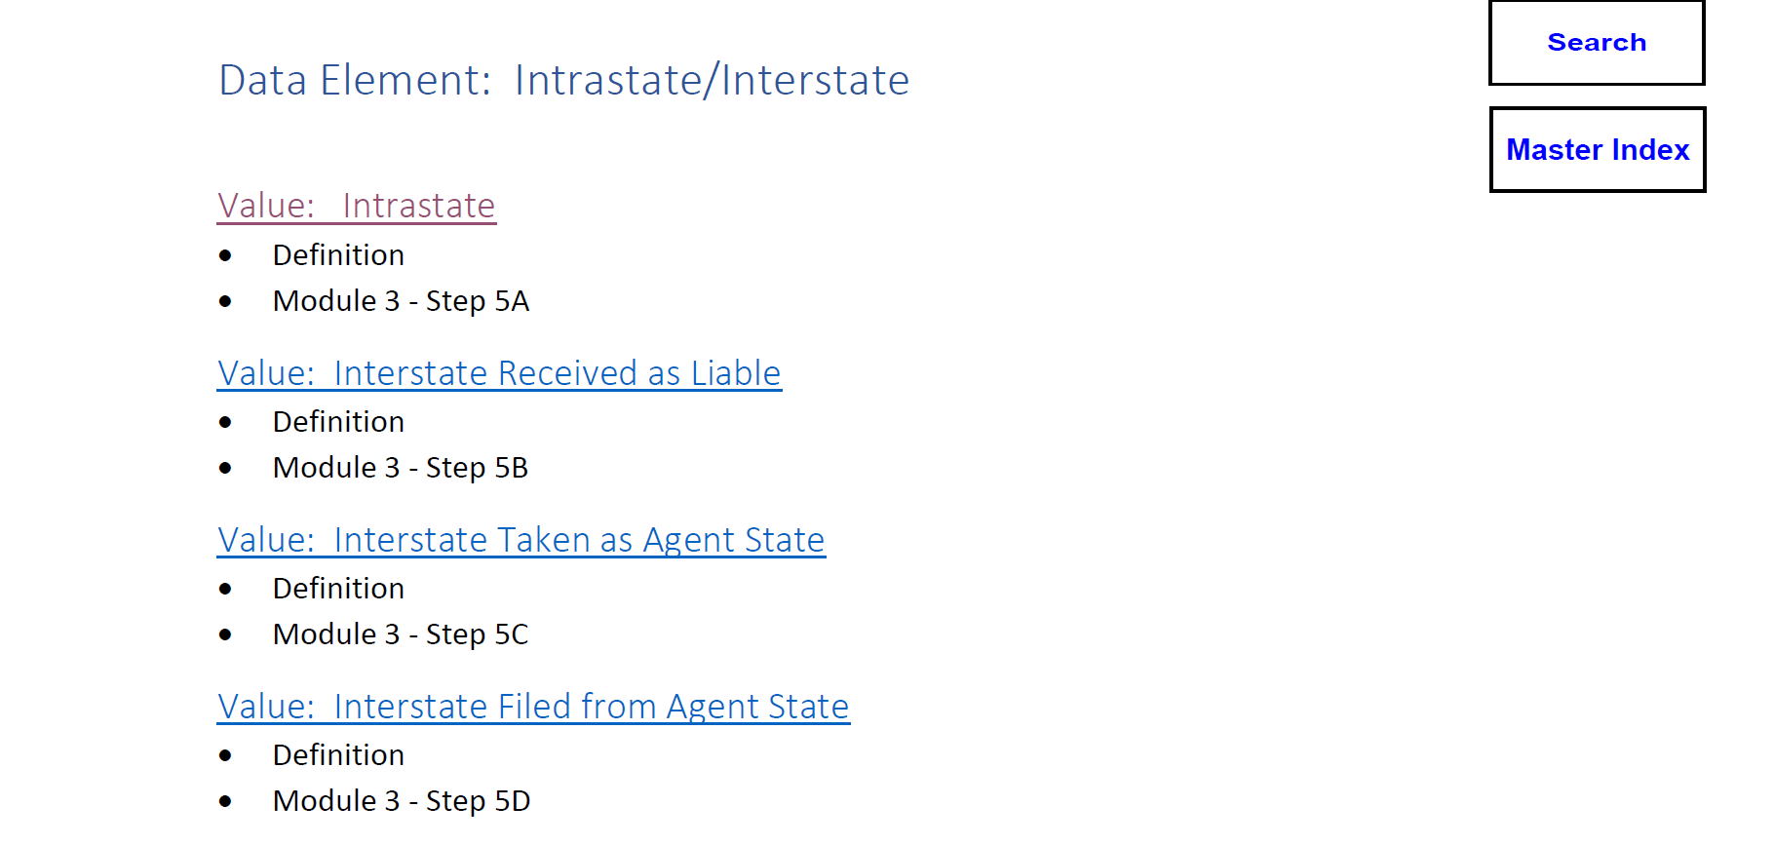
Other Data Elements that Validate Pop 1
Notes:
These Other Data Elements can be found separately/independently on KMS landing page under “Other Key Topics”. These are the data elements most likely to appear in many of the Benefits populations. For this example, we will look at Intrastate and Interstate Claims.

Slide 17
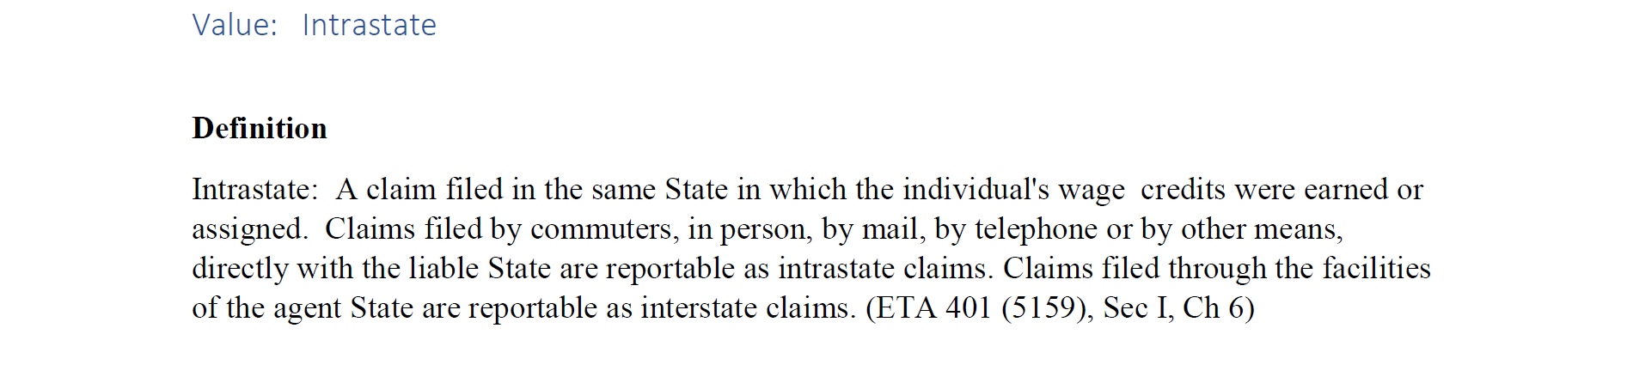
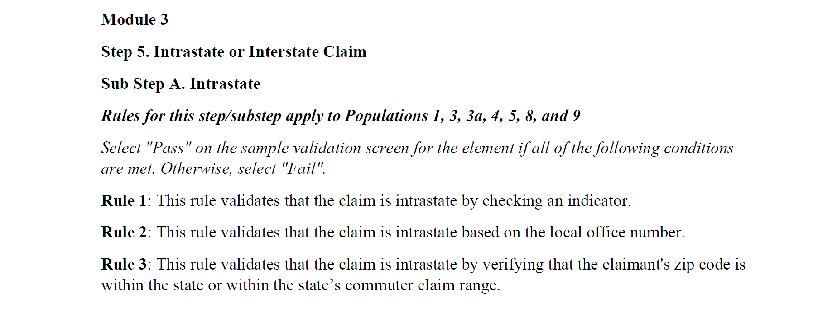
Definition and Module 3 Step/Rule(s)

Slide 18
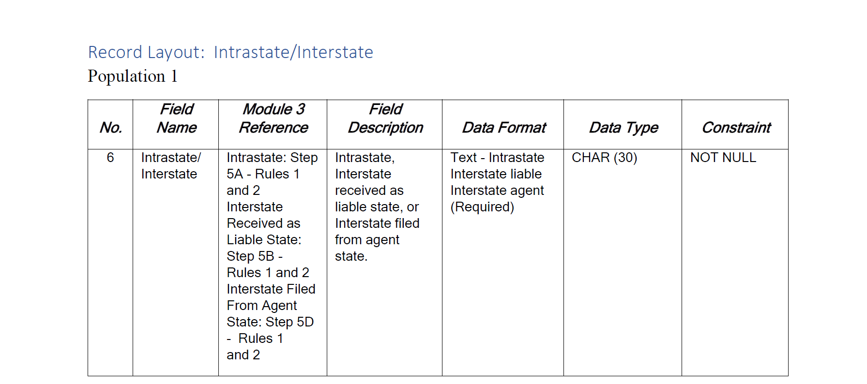
Record Layout by Population for this Data Element
Notes:
The Intra and Interstate claims data element is part of populations: 1, 3, 3a, 4, 5, 8 and 9

Slide 19
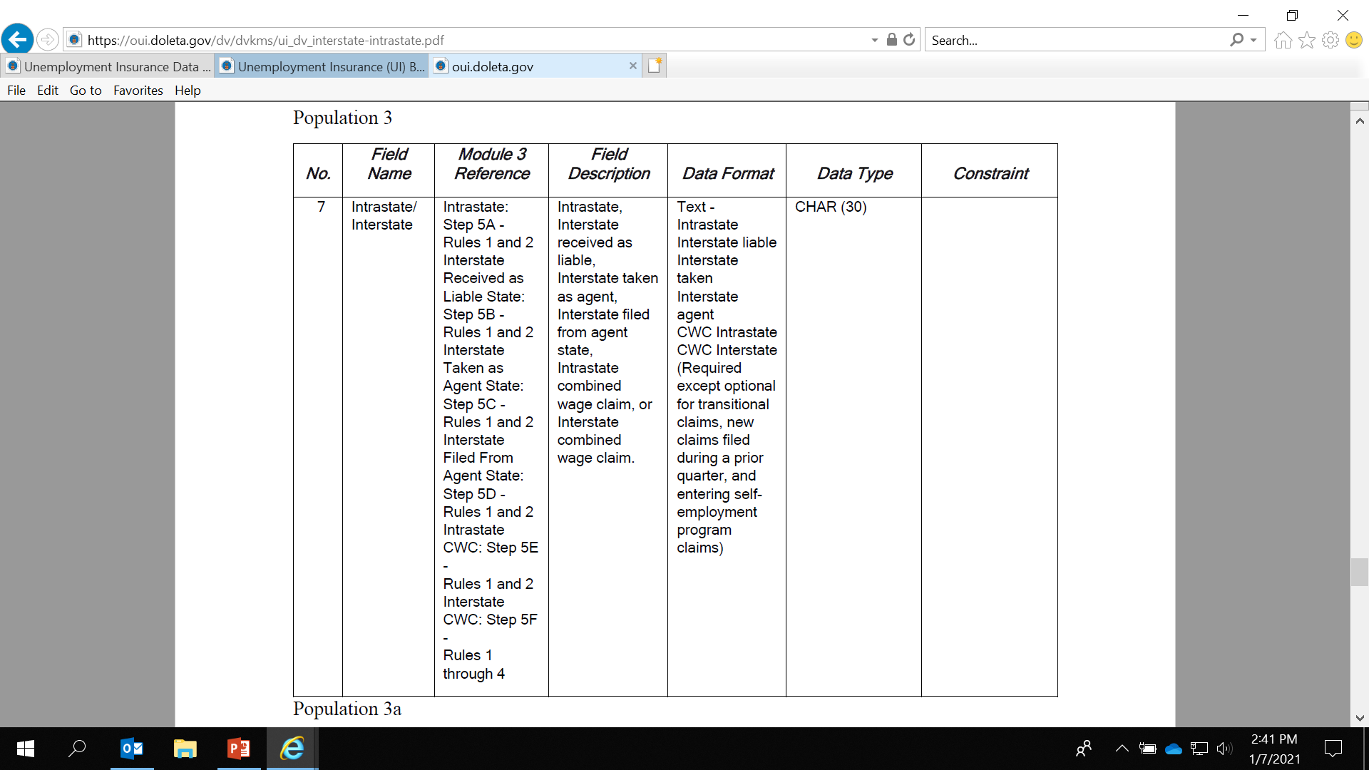
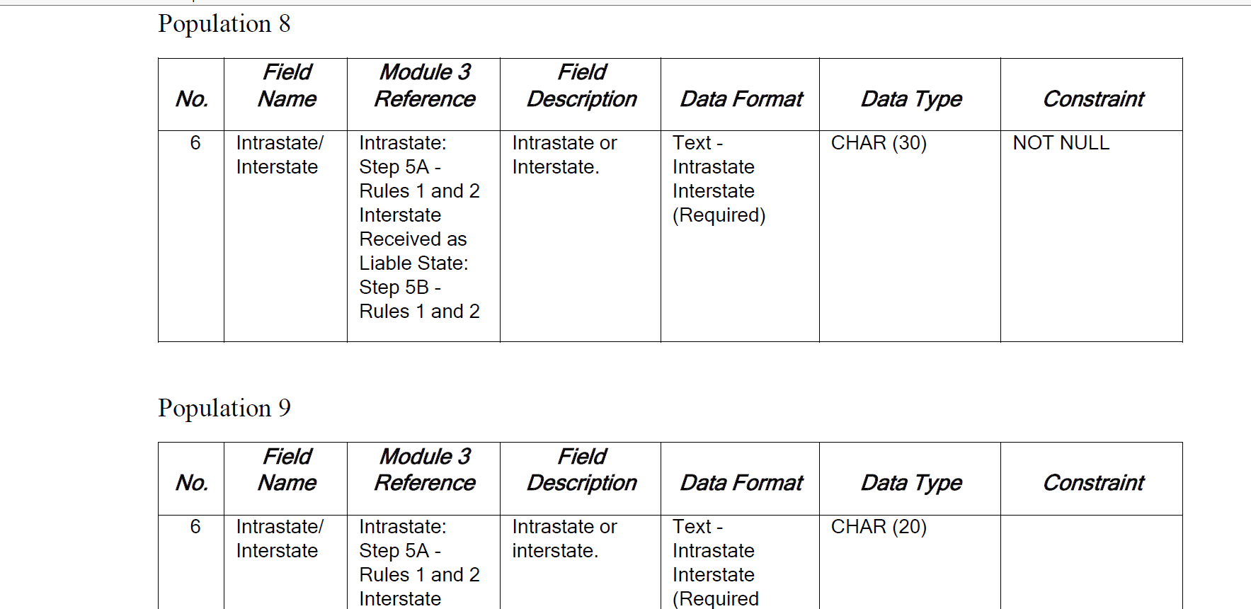
Notes:
Here you can see some examples of this data element repeating in the record layouts for some other populations

Slide 20
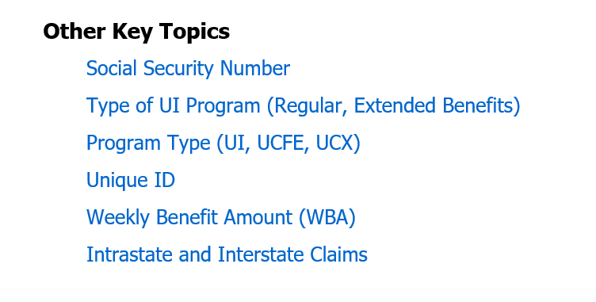
Concepts for Improving General DV Understanding
Notes:
Another Key Topic that is listed on the KMS homepage is Type of UI Program.

Slide 21
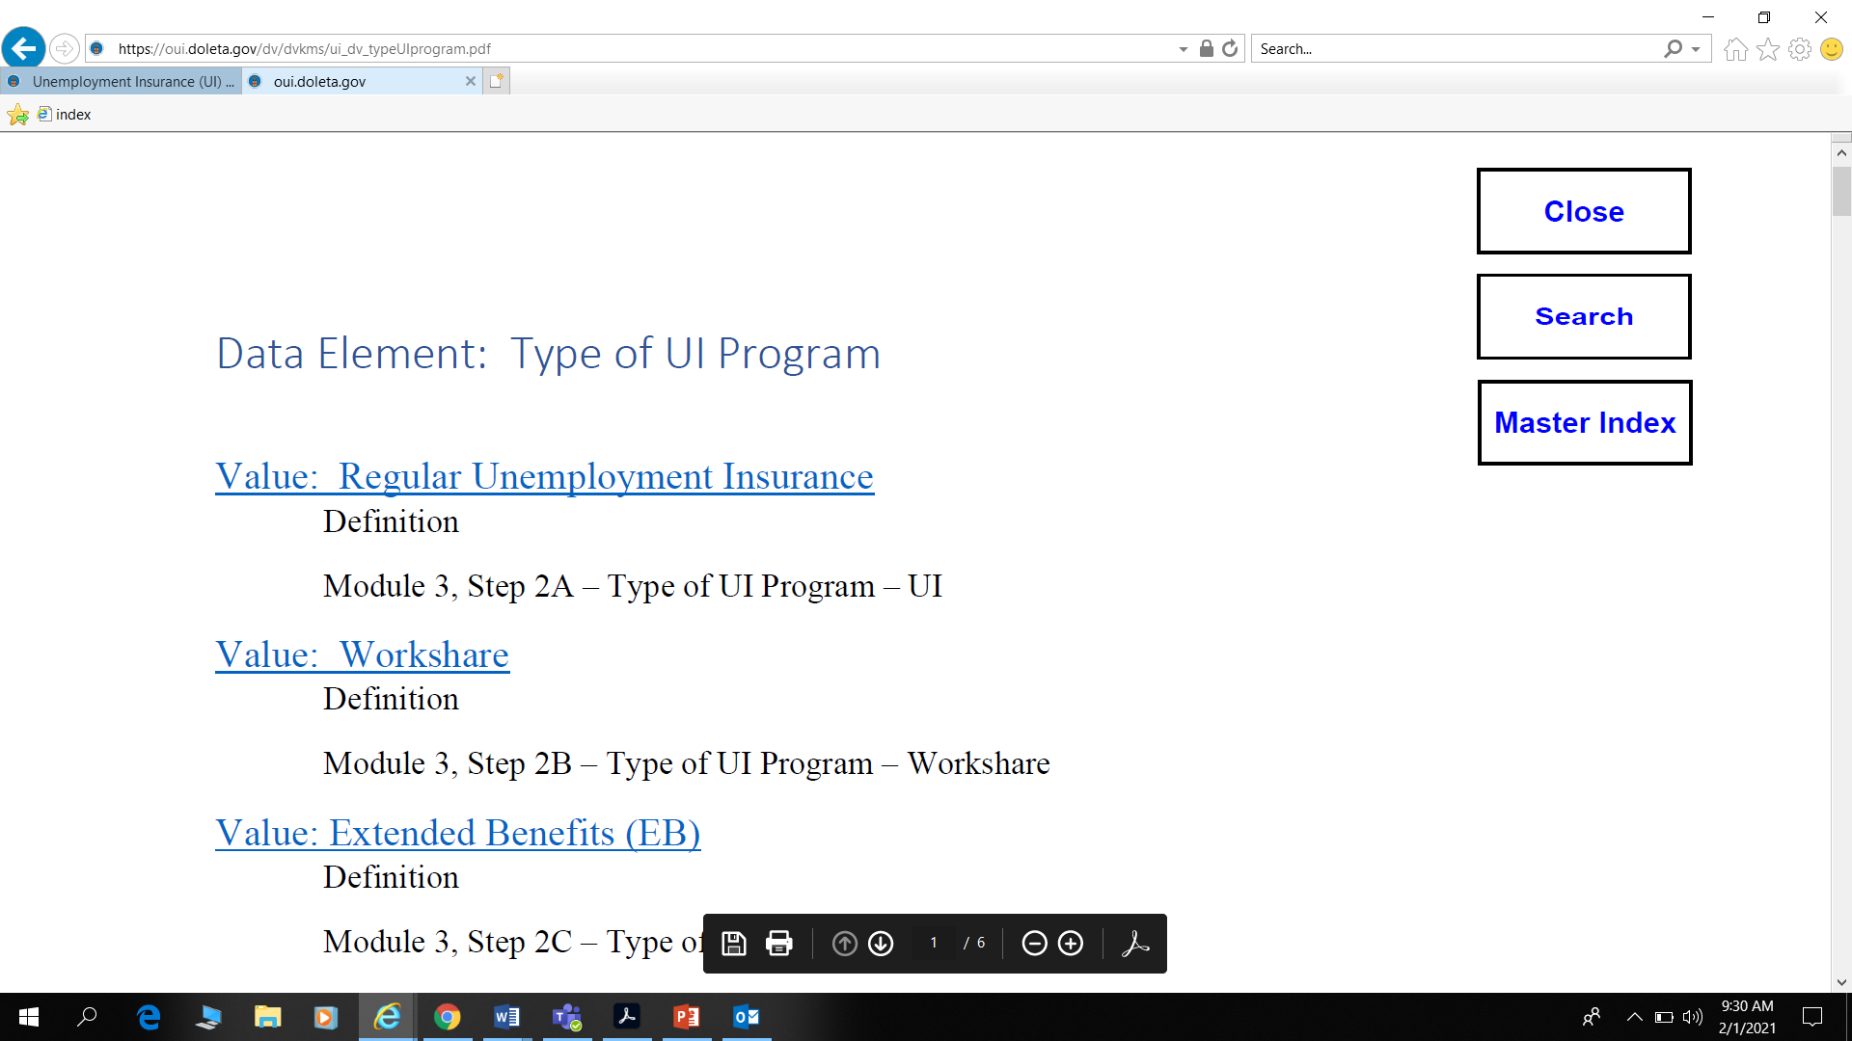
Notes:
Once you select Type of UI Program, you will be redirected to a new window. Here you will find the definitions from the ET Handbook 401, Module 3 information for each program type and the Record Layout. The Record Layout provides the format of this data element for the validation extract file. This is beneficial when correcting errors identified when uploading the extract file.
Workshare is included as these claims are used in the Overpayment population and the calculation towards a High Dollar OP ($25,000 threshold).
Temporary programs like those established in the CARES Act (PUA) are not validated.

Slide 22
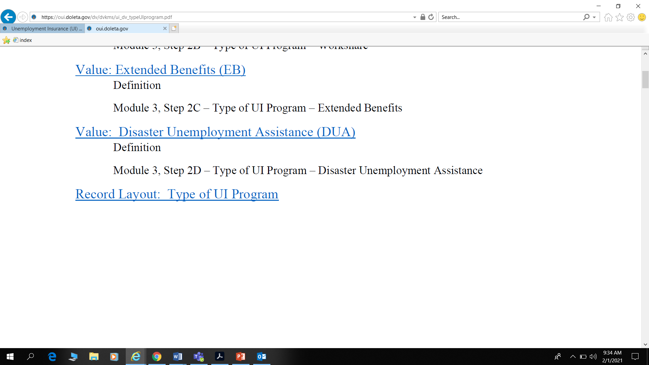
Notes:
EB is included like Workshare for the calculation of cumulative OP amounts towards the High Dollar OP threshold.
DUA is NOT validated and is included here under type of UI program as a “negative” validation – i.e. state validator, when checking type of UI program would NOT find DUA listed on a claimant’s profile (usually UI, sometimes EB); if find DUA – there is a problem with the extract file programming and the data element for that case/claimant/transaction would fail as part of Sample validation or Data Element Validation (DEV).

Slide 23
Questions during the Live Session
When will the Tax portion be made available?
  We’re working on developing a similar tool for the Tax DV program so stay tuned!
Will the extended deadline affect the program quarters we can validate for that time?
  No. Please validate any report month or quarter between
  April 1, 2020 and March 31, 2021
Our system admin sent over the access request form for DV. What would be a usual turnaround time on your end to process?
  Usually a couple days; please send the form to the email address on the next slide and we will work on processing this request.

Slide 24
Questions during the Live Session
Will they leave Module 3 Certification Portal open longer as well, until August 10, 2021?
  Yes - we’re working on this request with the IT team and hope to have this change implemented in time for the new date. If this is not feasible, states will not be penalized and we will work directly with state to accept Module 3 publication if certification is not possible.
Did you say no validation for any federal programs
  Federal claims (UCFE/UCX) are validated. Federal CARES Act programs like PUA are NOT validated.
For the states that are due for monitoring this year, do you know when and how and it will be scheduled and performed?
  Please contact your Regional Office. Some flexibility will be needed and the regular DV monitoring cycle adjusted due to travel restrictions and safety concerns with the COVID-19 pandemic.

Slide 25

Web Address of DV KMS
Questions should be sent forward to dvrpts@uis.doleta.gov.
https://oui.doleta.gov/dv/index.asp
https://oui.doleta.gov/dv/dv_knwl_mgmt_sys.asp
    DV DEADLINE: Due Date Extension until August 10, 2021
    (April 1, 2020-March 31, 2021)
Notes:
We have a general inbox set up for users to send questions on the KMS
Also included the specific links to DV webpage and the landing page for the knowledge management system
In the next couple of weeks, the DV webpage will have a copy of today’s PowerPoint and the recording of the session
Lastly, in light of the continuing COVID pandemic – the DV deadline will be extended again for VY2021 until August 10, 2021

